Slide 1
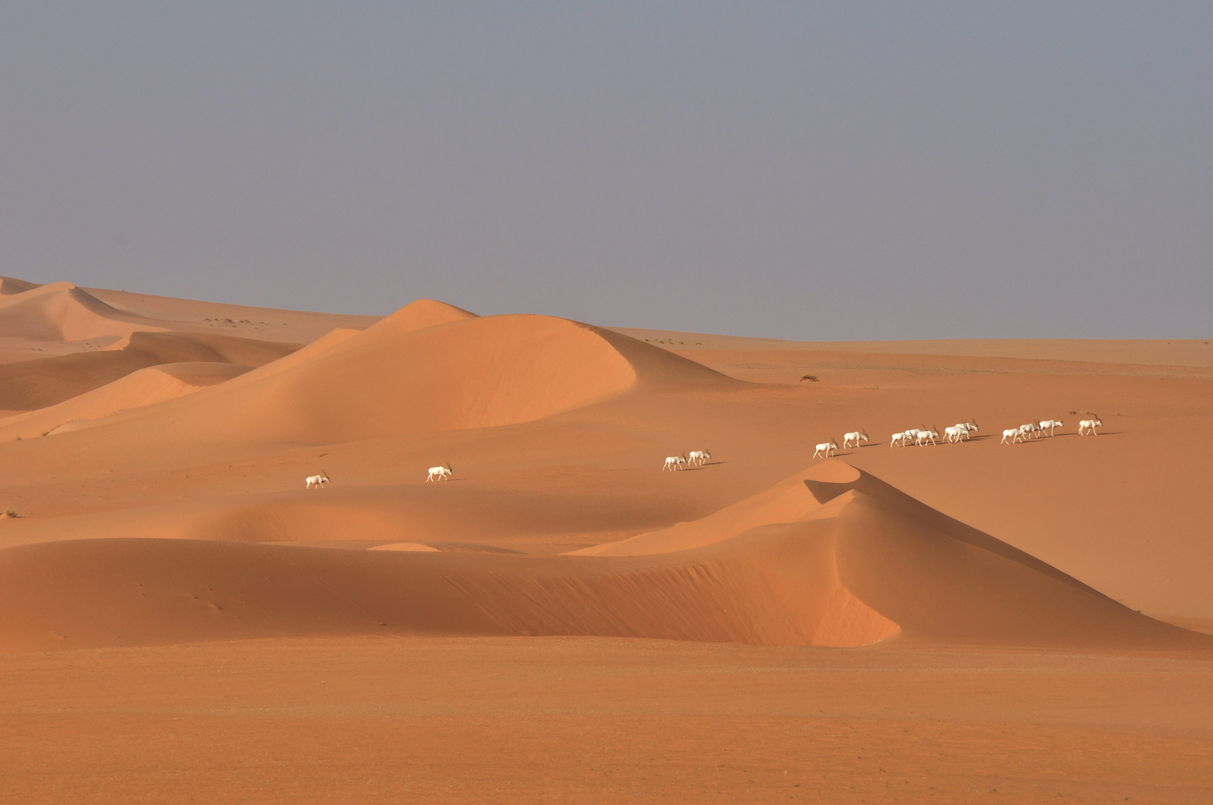



On the Brink of Extinction
Habitat Selection of Addax Across the Tin Toumma desert, Niger
Jared A. Stabach¹, Thomas Rabeil², Vincent Turmine, Tim Wacher³, Peter Leimgruber¹
¹Conservation Ecology Center, National Zoological Park, Smithsonian Conservation Biology Institute, Front Royal, USA
²Sahara Conservation Fund, L’Isle, CH
³Zoological Society of London, London, UK

Slide 2
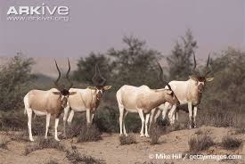
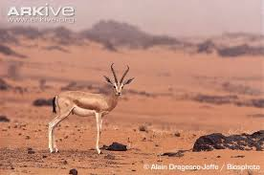
Addax/Dorcas gazelle
Critically endangered
Formerly widespread across Sahelo-Saharan Africa
Highly adapted to hyper-arid conditions
Current population estimate: < 100 individuals
Main threats:
Overhunting
Vulnerable
Habitat generalist
Perceived affinity to Sahelian regions
Current population estimate: 35,000-40,000 individuals
Main threats:
Loss of habitat, disturbance, overhunting
Notes:
Tin Toumma desert – population estimated to be 2,500 individuals

Slide 3
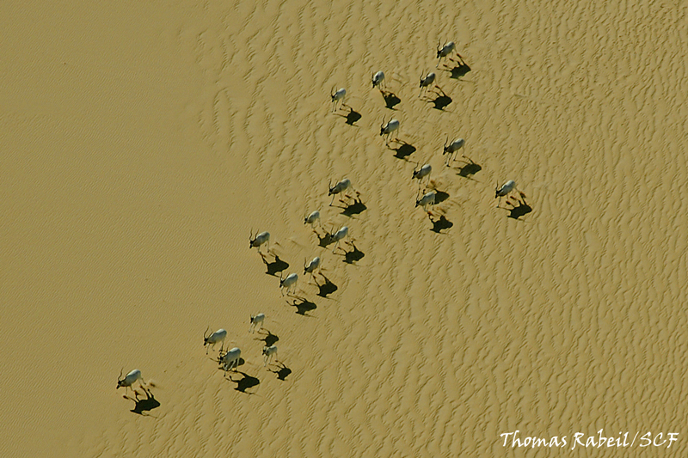
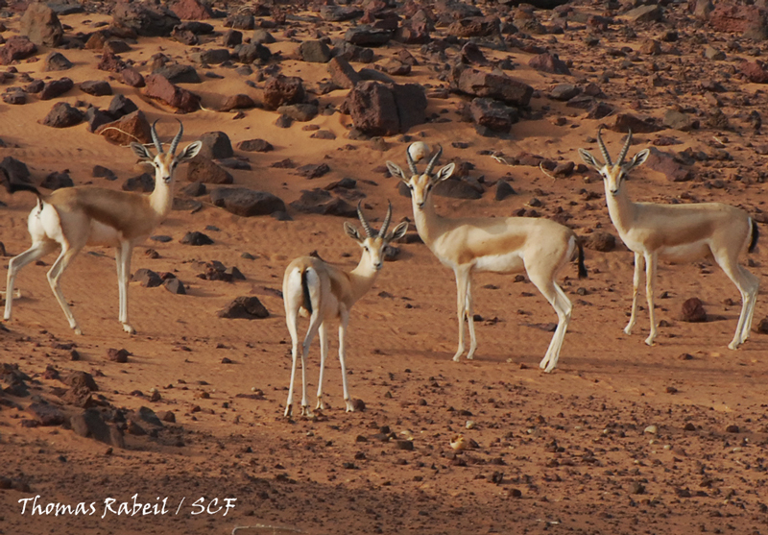
Research Objectives
1) Identify the factors contributing to increased habitat suitability
2) Examine shared resource use
3) Predict habitat suitability - guide future field surveys

Slide 4
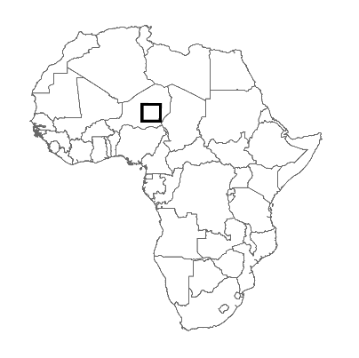
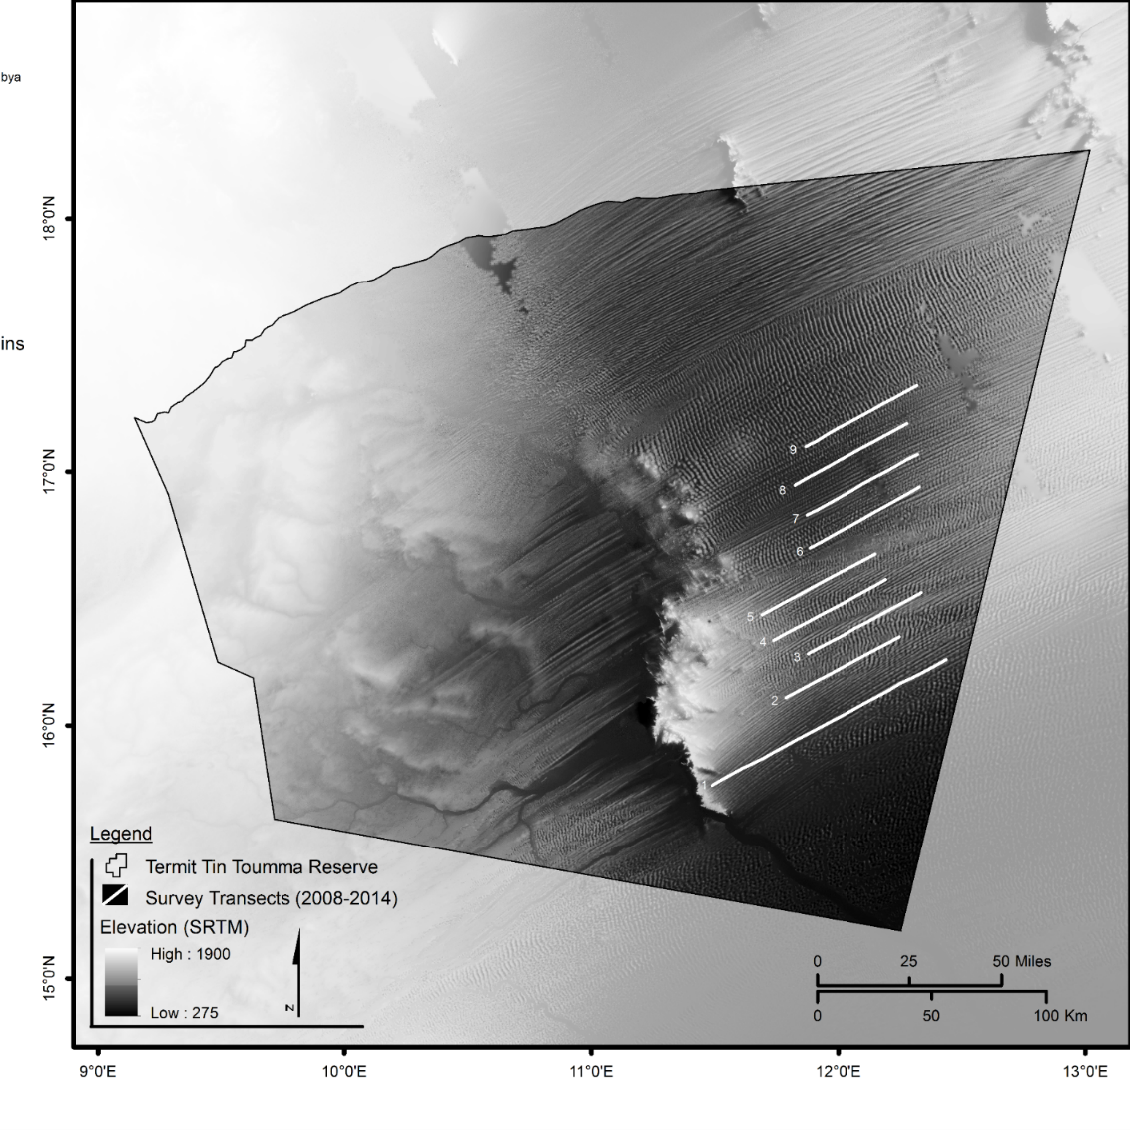
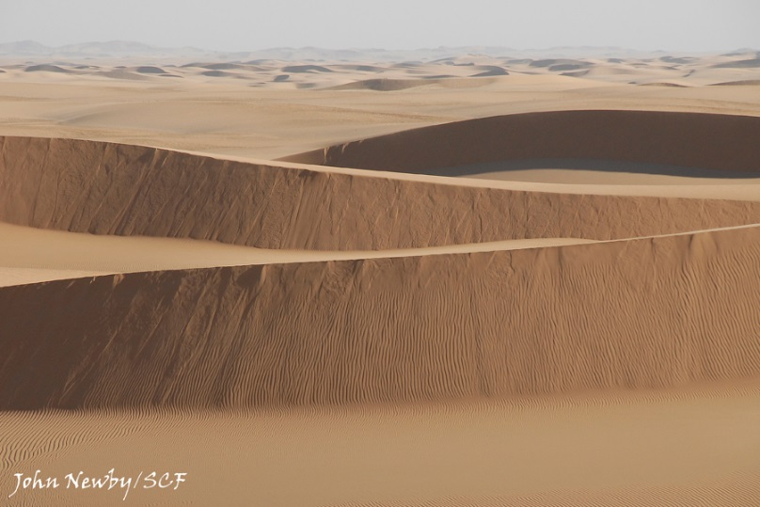
Study Design
Line transect sampling (2008-2014)
Vehicle surveys
Plot locations – 5 km apart
Air
Mountains
Ténéré erg
Bilma’s Great
erg
Termit
Massif
Notes:
Barkhan – crescent shaped dune…..produced by wind action predominately from one direction.
Erg – sand sea. Broad, flat area of desert covered with wind-swept sand with little or no vegetative cover.
Ecologically, the Tin Toumma represents the transition zone between Sahelian and Saharan ecosystems.
15-20 km h-1
50 km or 100 km
562 km covered by the transects
4-7 transects surveys at each time period.
Counted directory via sightings and indirectly via fresh tracks and feces within 500-m of the transect.

Slide 5
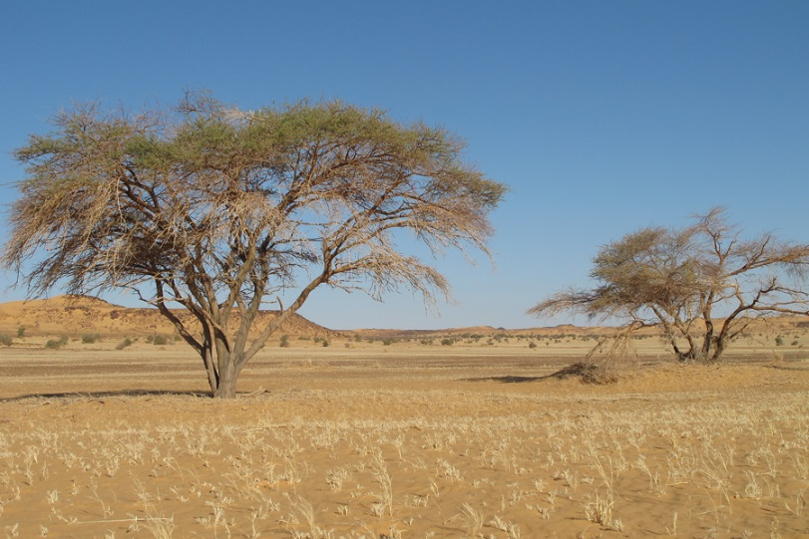
Study Design
Line transect sampling (2008-2014)
Vehicle surveys
Plot locations – 5 km apart
©SCF
Notes:
Barkhan – crescent shaped dune…..produced by wind action predominately from one direction.
Erg – sand sea. Broad, flat area of desert covered with wind-swept sand with little or no vegetative cover.
Ecologically, the Tin Toumma represents the transition zone between Sahelian and Saharan ecosystems.
15-20 km h-1
50 km or 100 km
562 km covered by the transects
4-7 transects surveys at each time period.

Slide 6
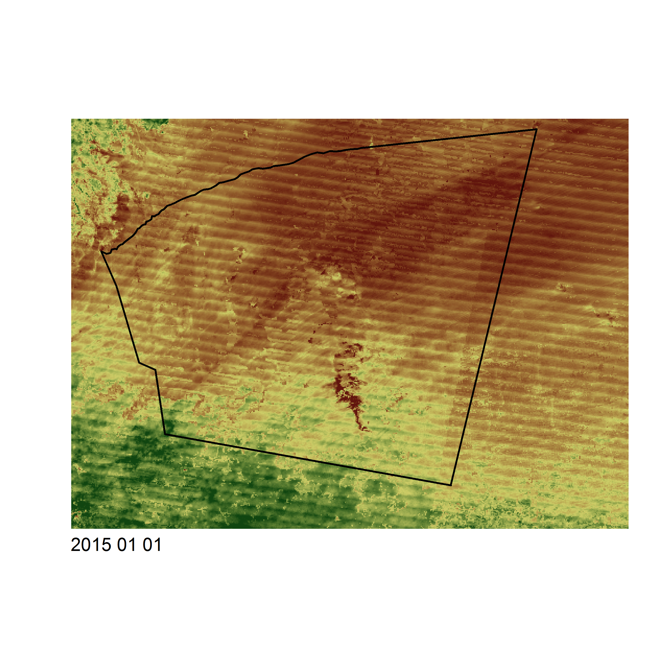
Environmental Variables
Remotely sensed variables
Surface Roughness
Difference in elevation between min/max values of a cell and its 8 surrounding neighbors
NDVI – Normalized Difference Vegetation Index
Vegetation greenness
Field variables
Occurrence of Addax/Dorcas gazelle
Occurrence of Human disturbance
Occurrence of Perennials
Stipagrostis vulnerans
Stipagrostis acutiflora
Cornulaca monacontha
Survey Season (Cold/Dry/Wet)
Survey Year (2008-2014)
Notes:
Dry (Mar-Jun); Wet (Jul-Oct); Cold (Nov-Feb)
Counts of Human disturbance, Addax/Dorcas…counted within 500-m of transect – We make the assumption here that if the species is present….it is detected. This is reasonable considering the landscape and the size of the species.

Slide 7
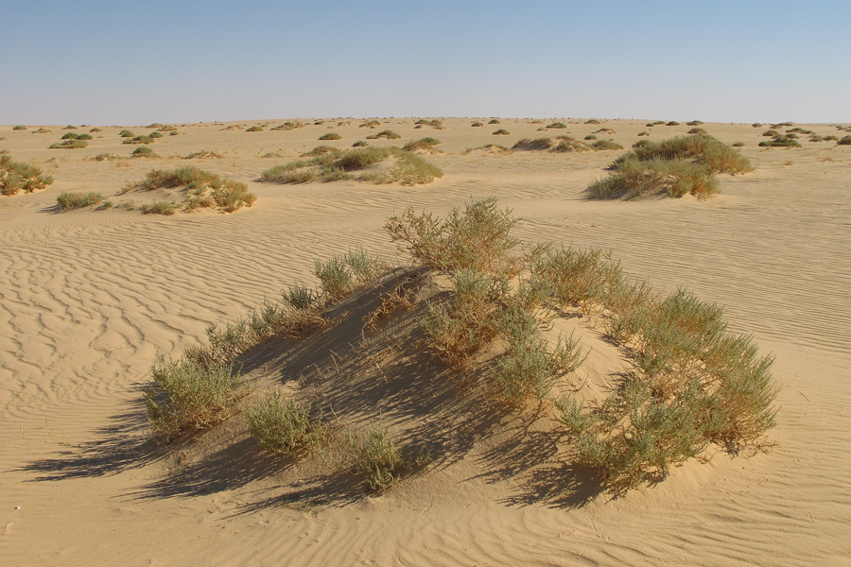
Environmental Variables
Remotely sensed variables
Surface Roughness
Difference in elevation between min/max values of a cell and its 8 surrounding neighbors
NDVI – Normalized Difference Vegetation Index
Vegetation greenness
Field variables
Occurrence of Addax/Dorcas gazelle
Occurrence of Human disturbance
Occurrence of Perennials
Stipagrostis vulnerans
Stipagrostis acutiflora
Cornulaca monacontha
Survey Season (Cold/Dry/Wet)
Survey Year (2008-2014)
©SCF
Notes:
Dry (Mar-Jun); Wet (Jul-Oct); Cold (Nov-Feb)
Counts of Human disturbance, Addax/Dorcas…counted within 500-m of transect – We make the assumption here that if the species is present….it is detected. This is reasonable considering the landscape and the size of the species.

Slide 8
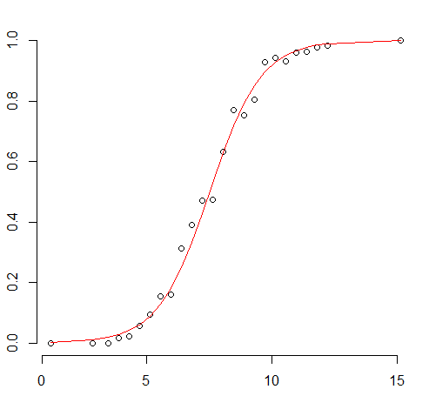
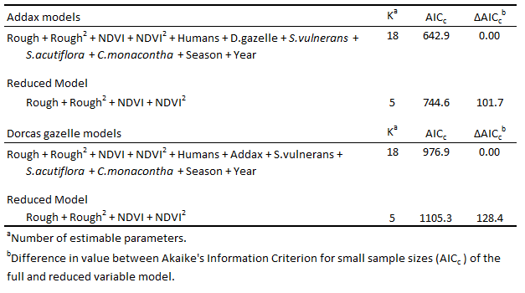
Model Structure
Generalized linear model (GLM) framework
Logistic regression
Probability of Occurrence
Landscape Variable

Slide 9
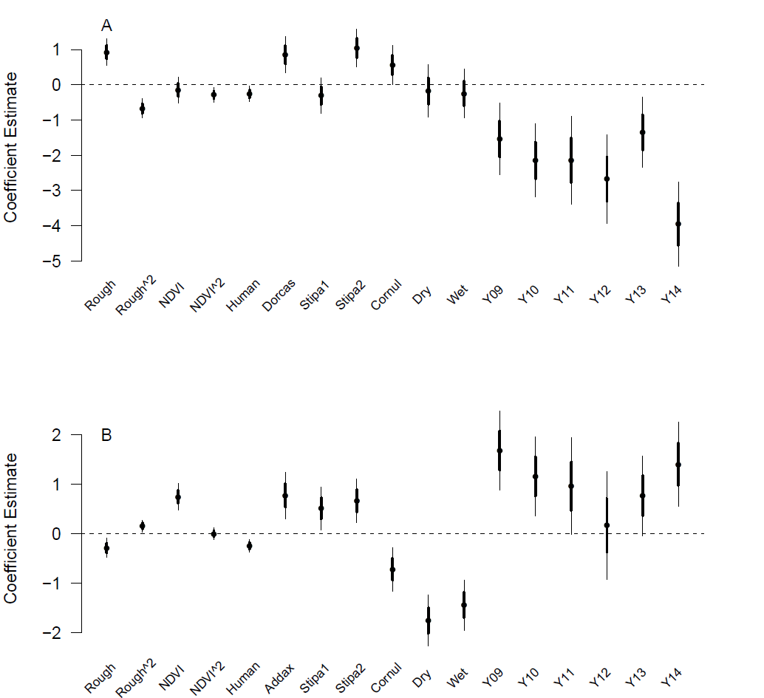
Results
Addax
Dorcas gazelle

Slide 10
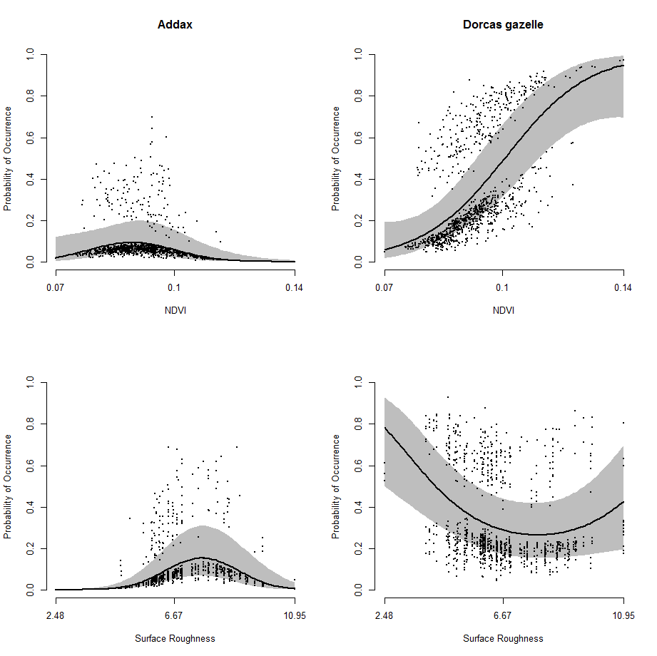
Results
Addax
Probability of Occurrence
NDVI
Surface Roughness
Dorcas gazelle
Probability of Occurrence
NDVI
Surface Roughness

Slide 11
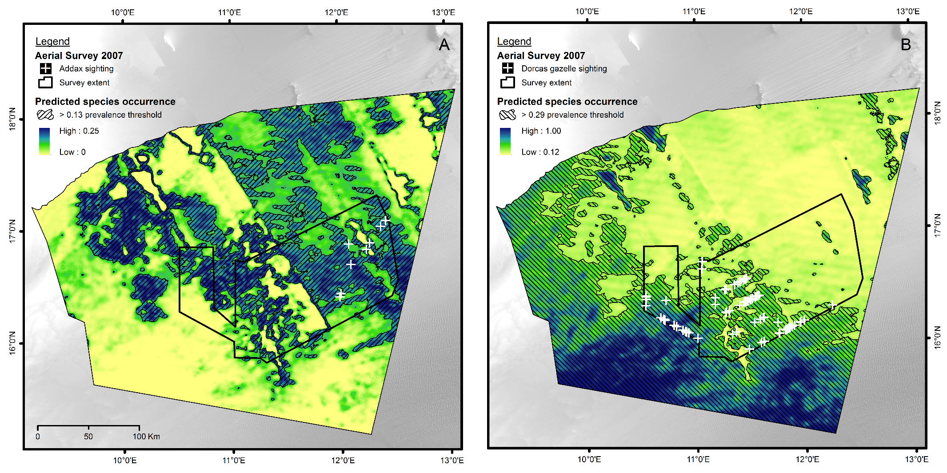
Results
Addax
Dorcas gazelle

Slide 12
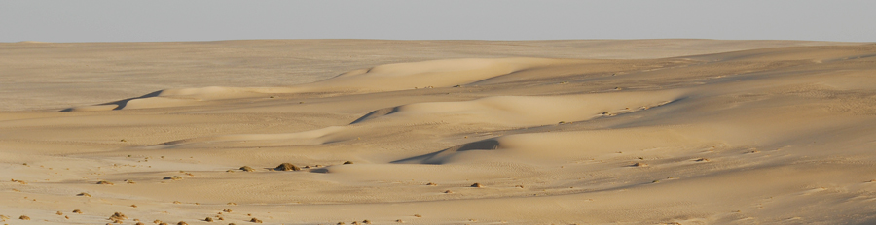
Summary
Addax - Year had the strongest effect in species occurrence models
Dorcas gazelle – Strong response to vegetation productivity
Significant spatial separation between the occurrence of addax and dorcas gazelle
Remote sensing data alone can help guide future field surveys
Urgent conservation action is required if these species are to persist into the future.
©SCF

Slide 13
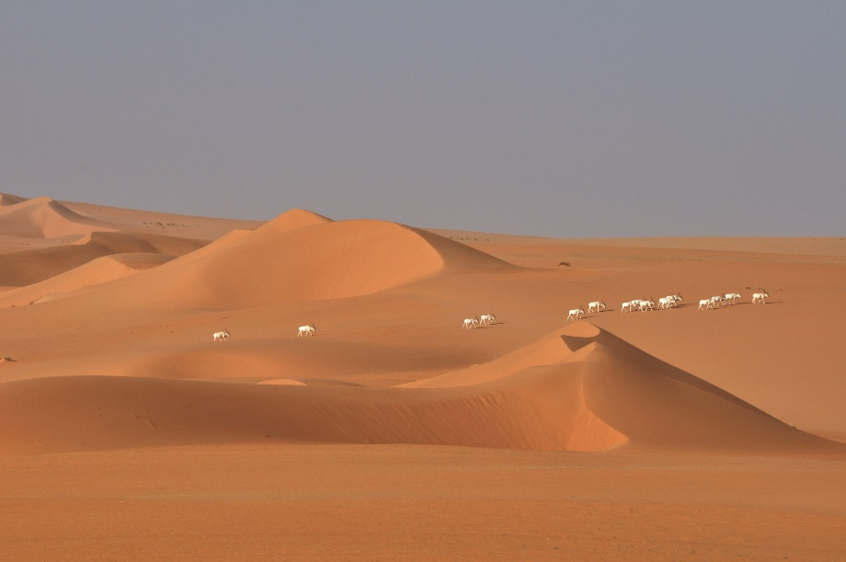

Acknowledgements
Funding and Support:
Sahara Conservation Fund
French Facility for Global Environment
European Union
Ministry of Environment – Niger
Directorate General of Water & Forestry – Niger
Department of Wildlife, Hunting and Protected Areas - Niger
The many local field assistants and staff members that made this research possible
©T.Rabeil, SCF

Slide 14
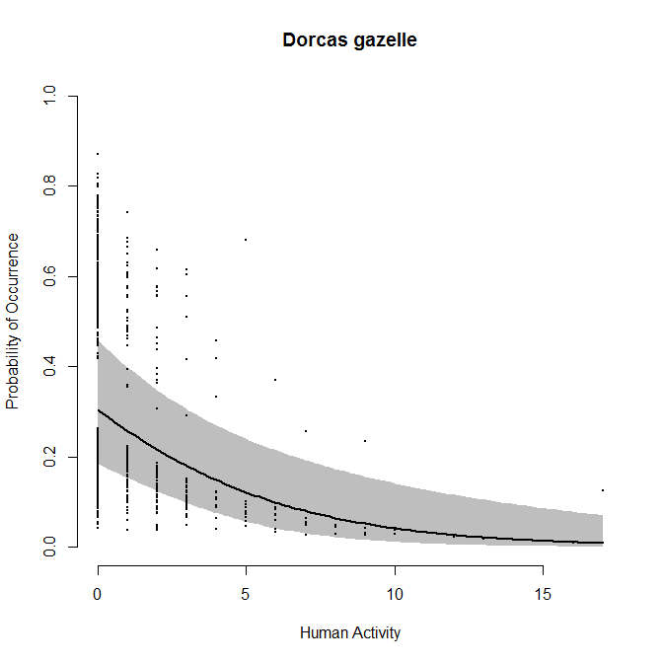
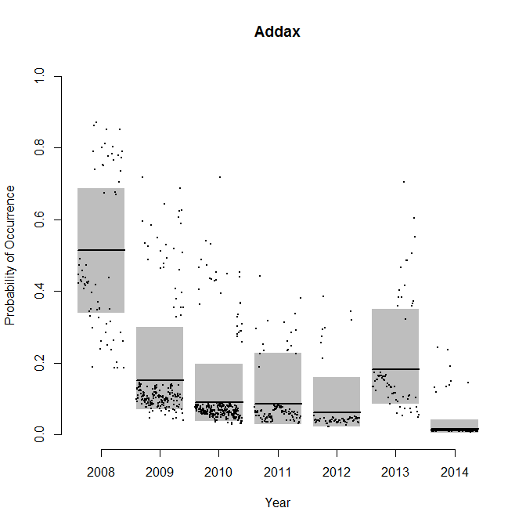
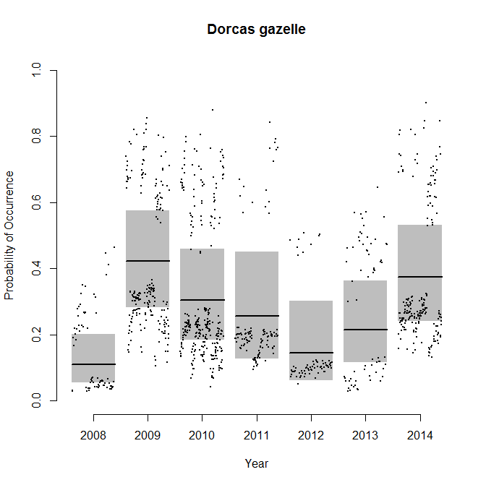
Results

